Slide 1
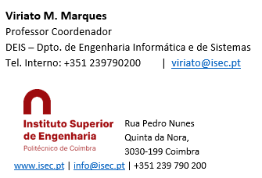
Sistemas de Informação II (LEI) Information Systems (ECS)
Lab Classes
4 – Integration Services

Slide 2
SQL Server + Data Tools + Visual Studio “work together” to provide 3 new and special kinds of projects (see the installation slides)
Integration Services (SSIS Projects) – for getting data from several sources (including SS databases), process, aggregate and load it into a database, usually a datwareouse (also called ETL – Extract, Transform and Load projects)
Analysis Services (SSAS Projects) – for developing an OLAP – Online Analytical Processing – project frequently called “cubes” and data analysis based on data mining algorithms
Reporting Services (SSRS Projects) – for developing interactive reports that can deployed to the Internet
The environment offered by SQL Server for developing these projects is in fact a group of new project types in Visual Studio, available after Data tools installation, and called BIDS – Business Intelligence Development Studio

Slide 3
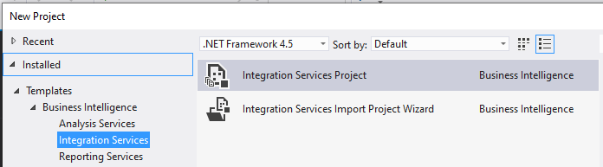
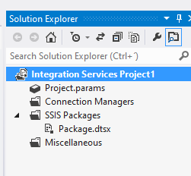
Create an Integration Services Project
Open Visual Studio executing as Administrator
File -> New Project -> Business Intelligence -> Integration Services Project (there may be slightly differences in this sequence depending on the version)
Give a name to your project and choose a location (folder) where to store it
On VS the window “Solution Explorer” should be visible and show something like the figure here on the right
Each application you’ll develop is called a SSIS package and will have the extension dtsx

Slide 4
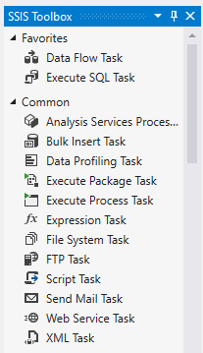
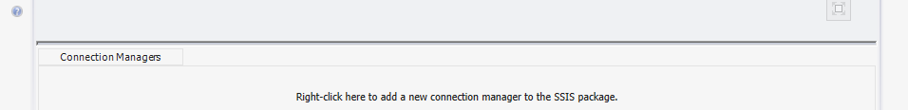
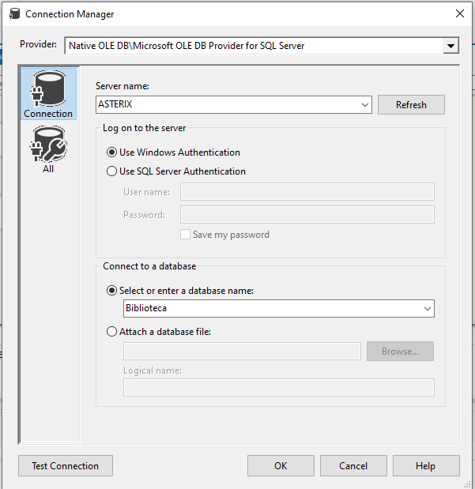
In order to develop a SSIS Project, the window SSIS Toolbos must be visible. If it isn’t, on the upper bar click View -> Other Windows -> SSIS Toolbox
Create the Connections to the DB and the DW
Create a Connection to de Library DB
On the bottom of the VS main window, you’ll see the Conection Manager Window
Right click it, choose OLE DB Provider for SQL Server (don’t confuse with ODBC Connection or SQL Server Client Connec: the former won’t work and te second may give problems too!)
On the form that appears, click New
On the dropdown, write the name of your computer or, if you have the Browser Service active, click and wait: it shoud appear
Then choose Use Windows Authentication (the “sa” and password login may result in permission errors during future Build Queries)
Finally, the name of your library database
Click Test Connection, Ok and close

Slide 5

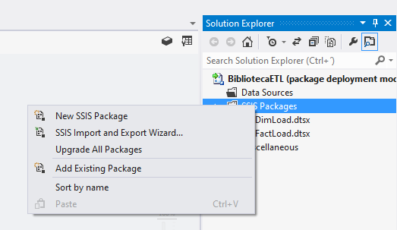
Repeat all this process but in the new connection, instead of specifying the library database name, now specify the data warehouse name
After this, you’ll have 2 connections, one for the DB and another for the DW, visibel in the Connection Manager on the bottom of Visual Studio
Create a Package named “DimLoad” for Loading the Dimension Tables
On the Solution Explorer right click SSIS Packages -> New SSIS Package
The Design Form appears (the window SSIS Toolbox should be visible! If it is not, activate it according to the instructions given before!)

Slide 6
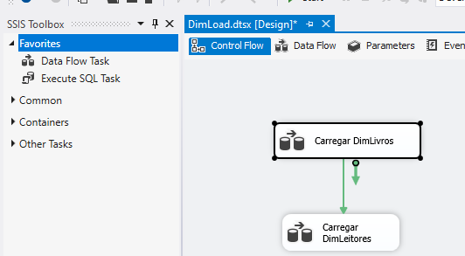
Click the separator Control Flow: here we’ll draw a general flow of the task we want. As we need to read data from the DB and write it into the DW, this is Data Flow Task:
On the SSIS ToolsBox look for this DataFlow task, drag and drop it on the Design Window
Change its name to “Carregar DimLivros” by gently clicking its name and rewriting it. This is the “block” responsible for Reading book data from the DB, processing it and writing it into the dimension DimLivros of the DW. We’ll see the details after;
Now, repeat this process to create another block named “Carregar DimLeitores”: this will be used to read and load data of the readers dimension
Then connect the first block to the second, to establish an operation order: click the first one; you’ll see a blue arrow. Just drag it to the second block.

Slide 7
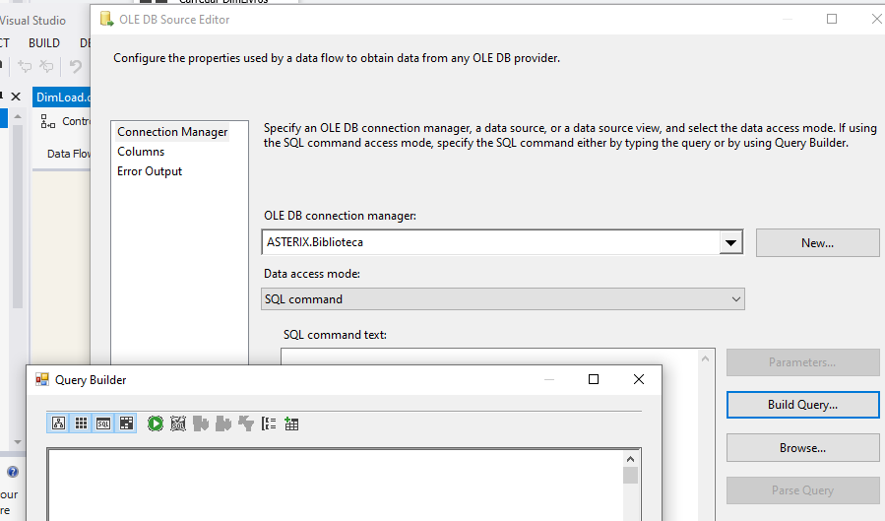
Now we’ll specify how reading and writing data is performed, inside each Data Flow Task:
Double click “Carregar DimLivros” or click it and select the separator “Data Flow”
A design area appears and the SSIS Toolbox changes: now there are more detailed operators…
On “Other Sources” of the SSIS toolbox, choose OLE DB Sources. Drag and drop it
Double click: the Source Editor window opens. Here we’ll build the query necessary to get the data needed to load the DimLivros table
We could simply directly write the SQL query on the “SQL Command text” window. However, I strongly recomend to use the “Build Query” option. This opens the Query Builder form where you can add and remove tables, change relationships, select the attributes you want, and the system will build the SQL query automatically. If needed, it can be edited after

Slide 8
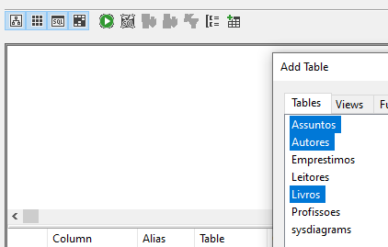
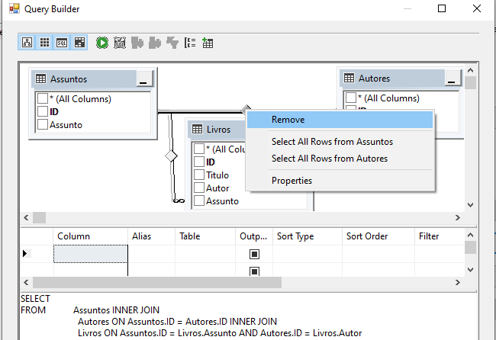
For filling DimLivros we need data from Livros, Autores and Assuntos. So, on the query builder click Add Table, choose these 3 tables and click Add. The 3 tables appear:
WARNING: Look at the relationships between them!! Very often tey are not correct! Here, there is a link between Assuntos and Autores that is not real! Remove it by clicking it and delete!
Then, click the attributes we need to fill the DimLivros. Thay are Assunto, Autor, Livros.ID and Titulo
As you click the fields, the system auto fills the query window
Close the Query Buider. On the Query Text you can manually edit the query but it is not the case here.
Click Preview. If results ok, close and save. This query is finished.

Slide 9
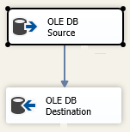
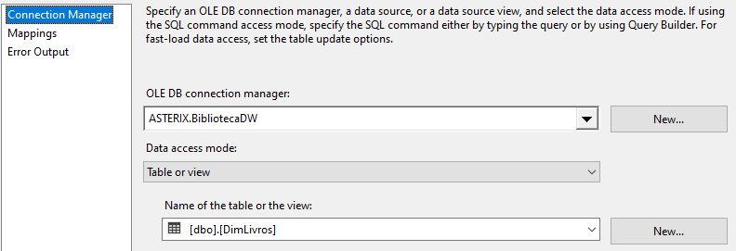
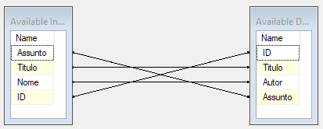
Now, back to the main window, drag and drop an OLE DB Destination task. This will be used to write the data of the previous query into the DImLivros table
Click the OLE DB Source task and drag the blue arrow to the OLE DB Destination task
To configure the OLE DB Destination, double click it
In the Connection Manager indicate the connection manager created for the DW
On Access Mode choose Table or View, as we will write directly to a table
Then fill the name of the table with de DimLivros table
Then select Mappings and verify if all the Source attributes are connected with a Destination attribute
Correct anything that may be needed: you can delete connections and create new ones, as needed.

Slide 10
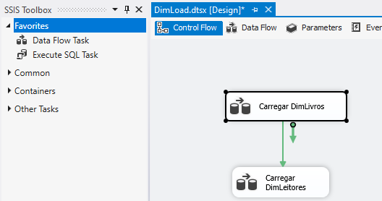
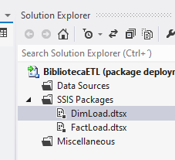
Now, back to the main window, click the Control Flow separator:
We have successfully finished to configure the Carregar DimLivros task
We need now something similar for the Carregar DimLeitores task. It is a similar procedure, even easier, because DimLeitores will take data from just 2 input tables instead of 3. Do it, confirming your query results in the Preview!
If all is ok, return to the Control Flow separator, close the window and save this package with the name “DimLoad” (or any other you may want to)

Slide 11
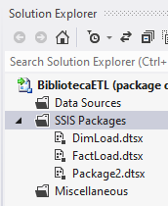
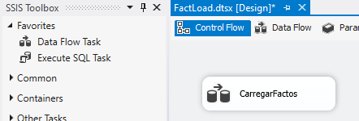
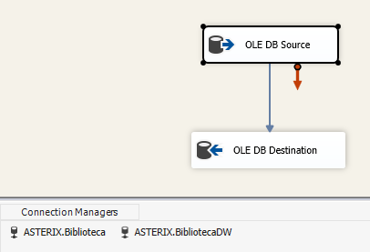
Create a Package named “FactLoad” for Loading the Fact Table
The procedure will be much the same as for creating the DimLoad package:
On the Solution Explorer create a new SSIS package
On the Connection Managers pane, right click, create a New OLE DB Connection: but now you’ll select the previously created connection to the library database, instead of havig to create a new one. Repeat this step for creating the connection to de data warehouse also selectiong the peviously created connection to the data warehouse
From de SSIS Toolbox, drag and drop a Data Flow task on the Control Flow Pane and rename it CarregarFactos
Then double click it or click on the Data Flow separator. Drag and drop a OLE DB Source and a OLE DB destination: the former will be used to read data from the database and the second to write it into the data warehouse. Click the data source and connect it to the data destination using the blue arrow

Slide 12
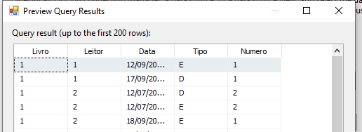
Double click the OLE DB Souce
Click Build Query in order to interactively buid the query to get the data. A form appears
Notice that now, the onl table you need in order to get the data for the fact table is the Emprestimos table. Add it by clicking the Add Table button
Select the needed fields: Livro, Leitor, Data, Tipo. The system will automatically build a query:
SELECT Livro, Leitor, Data, Tipo
FROM Emprestimos
However, now we’ll need to edit it manually:
First, we need to create our measure, that in this case will be just the counting of the records, as each one represents a lwnding or returning of a book
Then, we need to group these counting by each of the componentes of the Fact Table primary key. So, edit the above query manually and click Ok
SELECT Livro, Leitor, Data, Tipo, COUNT([*]) AS Numero
FROM Emprestimos
GROUP BY Livro, Leitor, Data, Tipo
On the next form test teh query, by clicking Preview, and Ok
NOTICE: It is very common that queris for loading fact tables have similar structures, i.e., COUNT or SUM operatores followed by a Group By of the fact table PK, as this implements the desired value aggregation

Slide 13
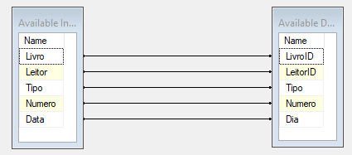
Double click the OLE DB Destination
Here we’ll proceed as before, just mapping the input fields (produced by the query) into the destination fact table. Create, edit or delete connections, as needed in orde to connect the correct fields
Testing the Project
In the SQL Server Configuration Manager be sure to have the DB and the Integration Services running
On the solution explorer click the DimLoad package
On the top tab of the project (Visual Sutdio) click the Start Button. The package runs and if all is ok you shoud get a green “V” near each of the OLE DB Source and OLE DB destination when it finishes
If you get a red cross, then there is an error. You’ll have to get and understand the errro message … that it is long and maybe dificult to understand …

Slide 14
If all is ok, then in the Soluton Explorer select the FactLoad package and run it. If there are errors, you must understand na dcorrect them. Then, run it again.
IMPORTANT NOTICES ABOUT ERRORS
After running / testing a package, you always have to explicitly stop it by clicking the Stop Debugging in the top options of VS (near the Start Button)
A common error is due to incompatible data types on source and destination tables. For exemple, if you have a source nvarchar type, it will not be possible to write it into a varchar, as information loss may occur. To correct these problems use the SSMS and change types as needed
After succesfully running a package, enter SSMS and verifythat the destination tables of the data warehouse are now populated with data. Verify if all seems ok (in this project, specially the number of lendings and returns in the fact table, generated by the COUNT commmand)
Once you succesfully run a package, if you try to run it again, you’ll get Duplicate Key errors. This is normal, as the data you are trying to insert into the data warehouse is already there. To solve the poblem, use SSMS and dele data from the data warehouse using SQL queries of type “Delete from [tablename]”.
Notice that in the data warehouse, the tables are connected by FKs. So, you have to delete data from the children tables before deleting from the parent tables! (for exemple, for deleting data from the Authors dimension, you must delete the records from the fact table first, as this table references the dimension table)

Slide 15
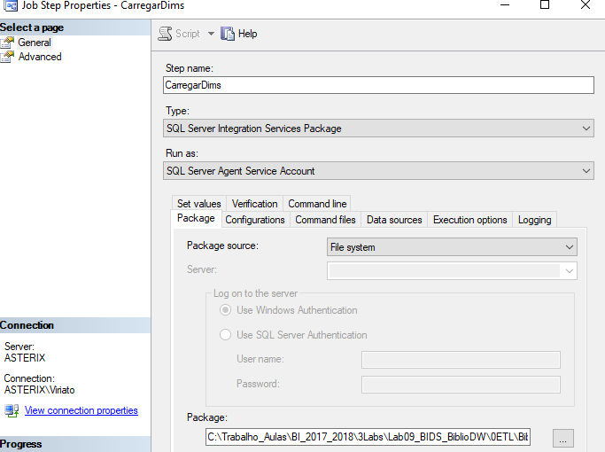
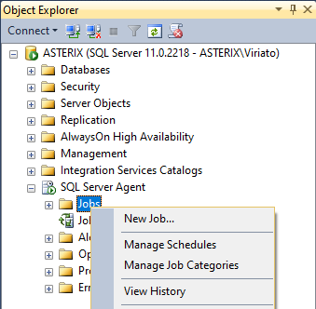
Integration Services Scheduling
An Integration Services package can be run manually or automatically scheduled. To Schedule it:
Enter the SSCM and start the Agent Service
Enter the SSMS: the last option is the SQL Server Agent. To create a scedule, right click it and then New Job. The optons and forms are self- explanatory. Explore them
NOTICE
In the Job Steps properties window, fill SQL Server Integration Services Package and then look, in your disk, for the package you wish to run and fill it in the Package box. SSIS Packages have a dtsx extension

Slide 16
Integration Services
END

